Slide 1
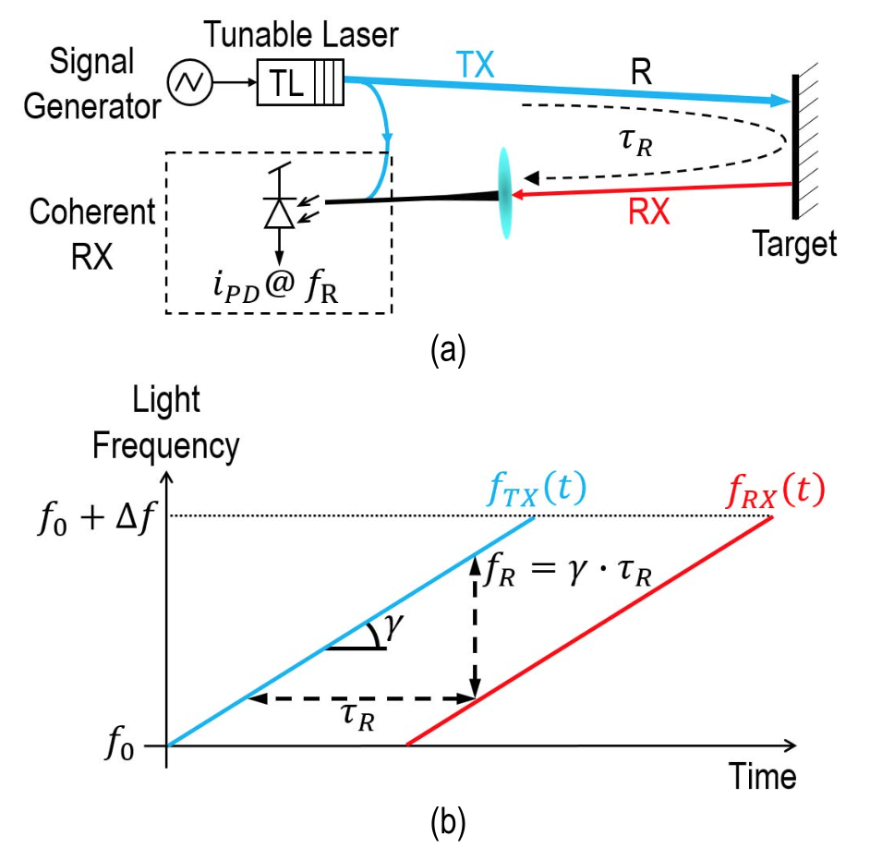
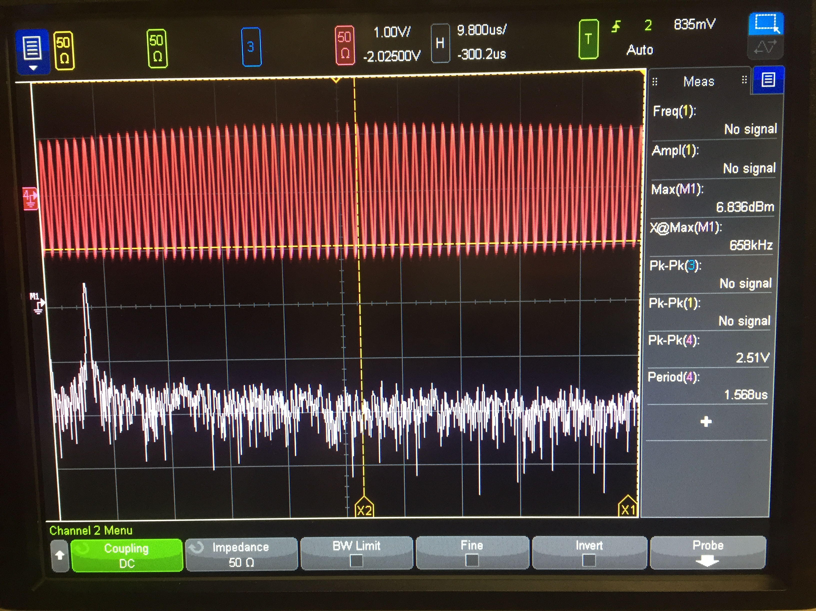
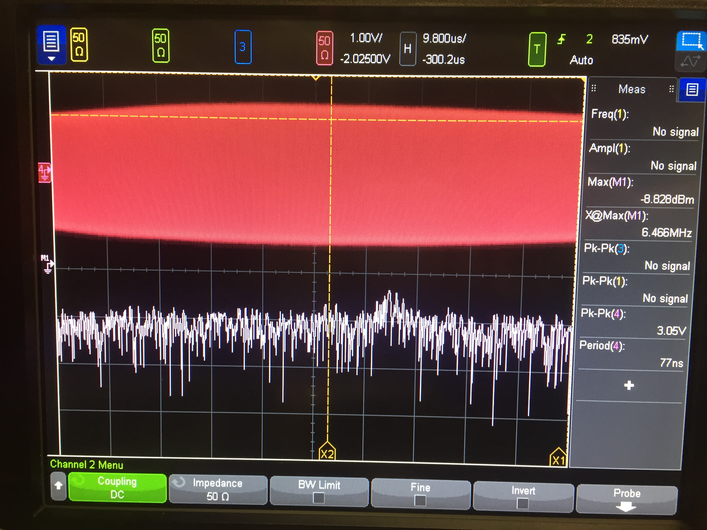
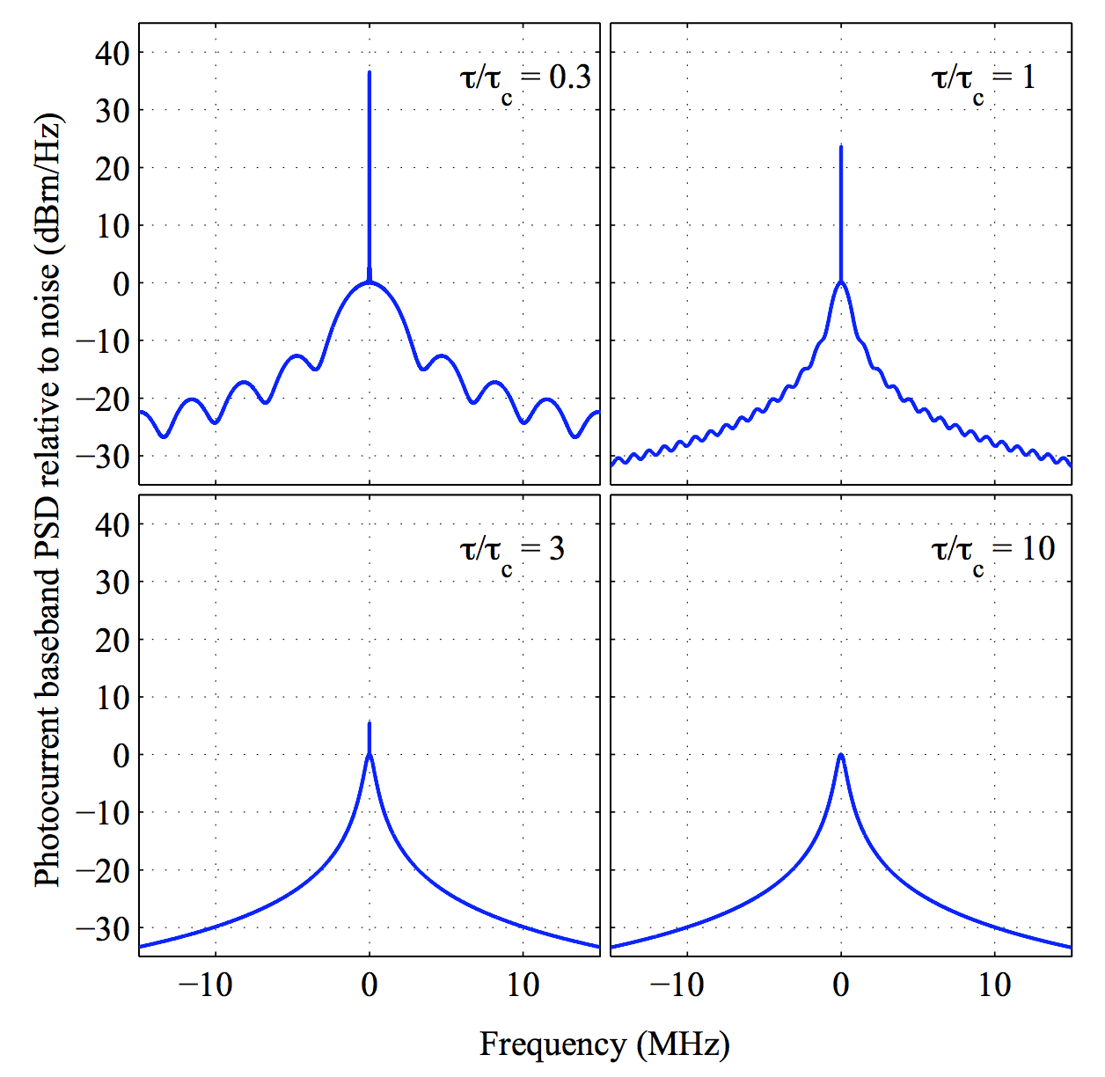
Phase noise problem
20cm
2m
As 𝜏_{R} goes up, PN of TX/RX beams are less correlated (less coherent)
Beating tone becomes weaker & noise floor go up
[Vasilyev 2013]

Slide 2
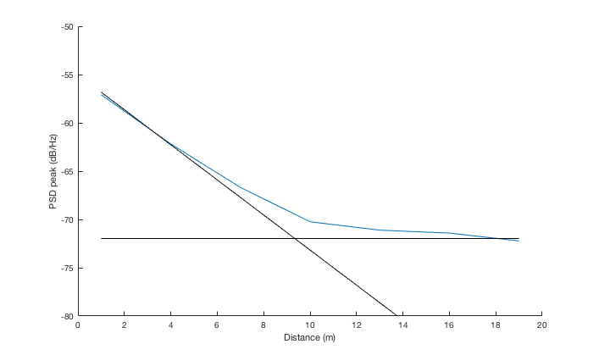
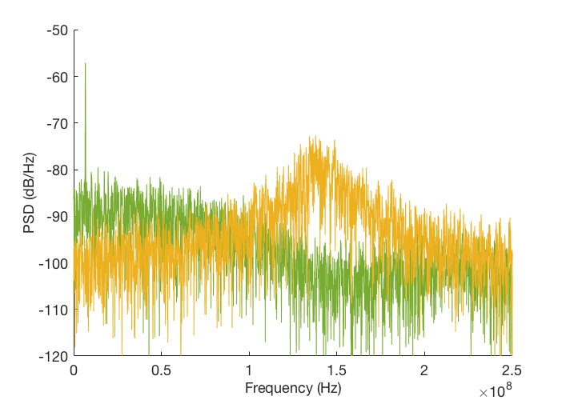
Phase noise example
Photocurrent PSD from theory
Even without shot noise, ranging accuracy is fundamentally limited by PN
Beyond coherence length (tau>tau_c), it’s just Lorentzian lineshape + shot noise floor
Linewidth: 10MHz
Coherence range: 4.77m
Scan time: 10us
1m
20m
Phase noise pedestal peak
Coherence range
Signal power
Notes:
S_i(f) = \frac{{i_0}^2}{2}\left[ \frac{{\tau}_c/(2\pi)}{1+\left(\pi f {\tau}_c \right)^2} \left\{ 1- e^{-\frac{2\tau}{{\tau}_c}} \left[ \cos(2\pi f\tau) + \frac{1}{\pi f \tau_c} \sin(2\pi f \tau) \right] \right\} \right]
\tau_c = \frac{2}{\textrm{linewidth}},\quad i_0: \textrm{nominal photocurrent amplitude},\quad \tau: \textrm{path delay}

Slide 3
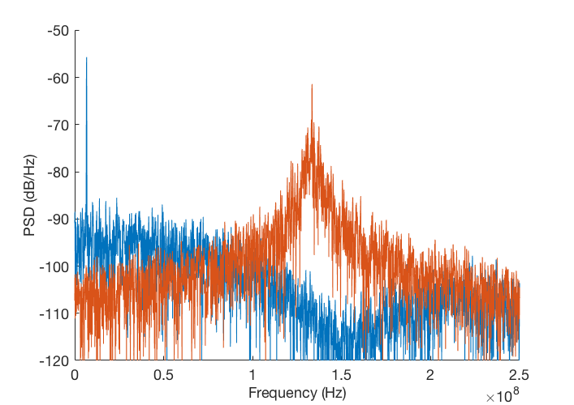
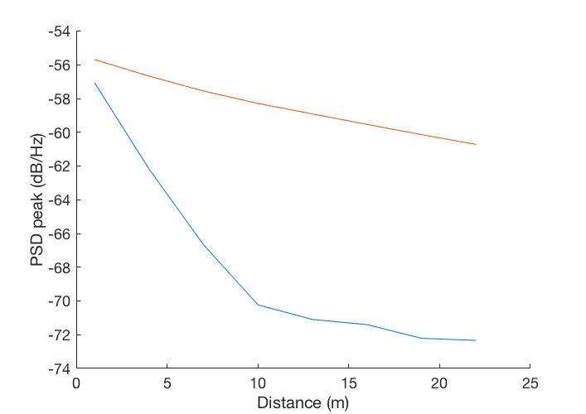
Phase noise example
1m
Scan time: 10us
20m
Linewidth: 2MHz²/Hz
1m
Linewidth: 10MHz²/Hz
20m
Notes:
S_i(f) = \frac{{i_0}^2}{2}\left[ \frac{{\tau}_c/(2\pi)}{1+\left(\pi f {\tau}_c \right)^2} \left\{ 1- e^{-\frac{2\tau}{{\tau}_c}} \left[ \cos(2\pi f\tau) + \frac{1}{\pi f \tau_c} \sin(2\pi f \tau) \right] \right\} \right]
\tau_c = \frac{2}{\textrm{linewidth}},\quad i_0: \textrm{nominal photocurrent amplitude},\quad \tau: \textrm{path delay}

Slide 4
Phase noise example
Photocurrent PSD from theory
Even without shot noise, ranging accuracy is fundamentally limited by PN
Beyond coherence length (tau>tau_c), it’s just Lorentzian lineshape + shot noise floor
Linewidth: 10MHz
Coherence range: 4.77m
Scan time: 10us
Even beyond coherence range, it is still possible to estimate the distance from Lorentzian lineshape (just less accurate)
Beyond coherence range, PSD peak height is constant (function of linewidth)
1m
20m
Phase noise pedestal peak
Coherence range
Signal power
Notes:
S_i(f) = \frac{{i_0}^2}{2}\left[ \frac{{\tau}_c/(2\pi)}{1+\left(\pi f {\tau}_c \right)^2} \left\{ 1- e^{-\frac{2\tau}{{\tau}_c}} \left[ \cos(2\pi f\tau) + \frac{1}{\pi f \tau_c} \sin(2\pi f \tau) \right] \right\} \right]
\tau_c = \frac{2}{\textrm{linewidth}},\quad i_0: \textrm{nominal photocurrent amplitude},\quad \tau: \textrm{path delay}

Slide 5
Detector for long-distance targets
Common belief: targets should always be within the coherence range
Significantly constrains linewidth spec for tunable laser
However, if we can assume there’s single scatterer, we can fit the PSD estimate to the known shape (Lorentzian) to get better distance estimate than just (FFT → peak-finding)
Problem of super-resolution
Lorentzian lineshape + shot noise floor
Notes:
S_i(f) = \frac{{i_0}^2}{2}\left[ \frac{{\tau}_c/(2\pi)}{1+\left(\pi f {\tau}_c \right)^2} \left\{ 1- e^{-\frac{2\tau}{{\tau}_c}} \left[ \cos(2\pi f\tau) + \frac{1}{\pi f \tau_c} \sin(2\pi f \tau) \right] \right\} \right]
\tau_c = \frac{2}{\textrm{linewidth}},\quad i_0: \textrm{nominal photocurrent amplitude},\quad \tau: \textrm{path delay}

Slide 6
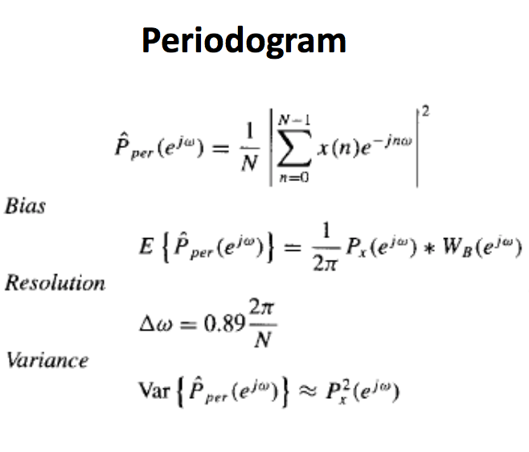
Fitting
Procedure
Estimate PSD from time-domain signal with FFT (periodogram)
Then apply fitting with known Lorentzian prior
Fitting methods
(Nonlinear) least squares estimation (LSE)
Maximum likelihood estimation (MLE)
MLE can be better, as it can take into account the uneven estimation variance of periodogram over frequency bins
For periodogram estimation, variance is bigger for bins with higher power
(just like shot-noise limited photodetectors)
Notes:
S_i(f) = \frac{{i_0}^2}{2}\left[ \frac{{\tau}_c/(2\pi)}{1+\left(\pi f {\tau}_c \right)^2} \left\{ 1- e^{-\frac{2\tau}{{\tau}_c}} \left[ \cos(2\pi f\tau) + \frac{1}{\pi f \tau_c} \sin(2\pi f \tau) \right] \right\} \right]
\tau_c = \frac{2}{\textrm{linewidth}},\quad i_0: \textrm{nominal photocurrent amplitude},\quad \tau: \textrm{path delay}

Slide 7
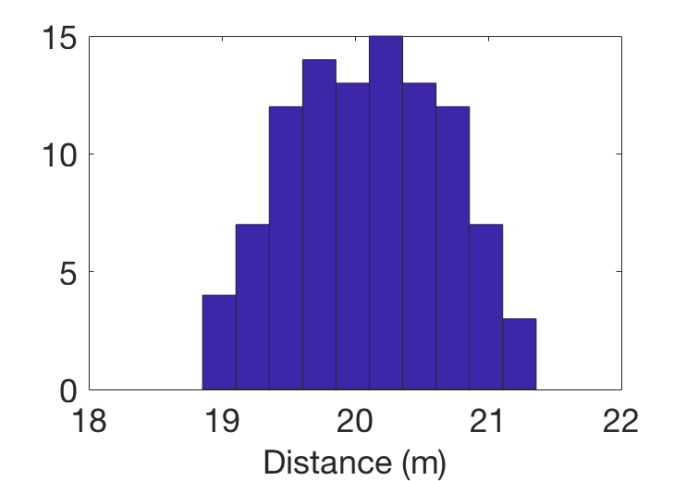
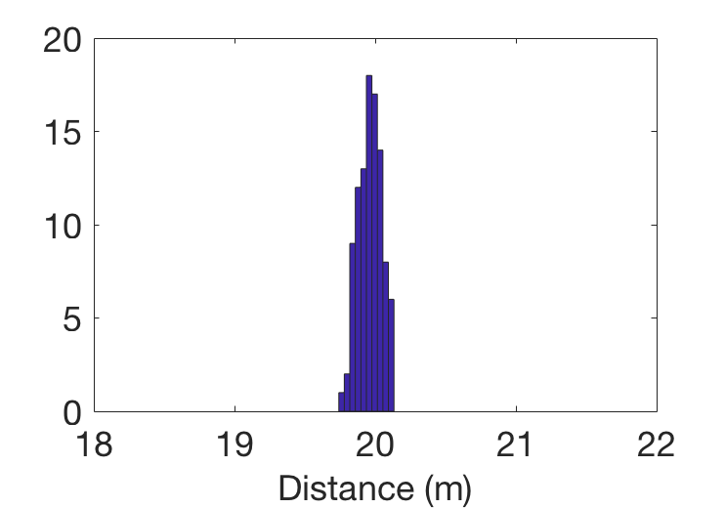
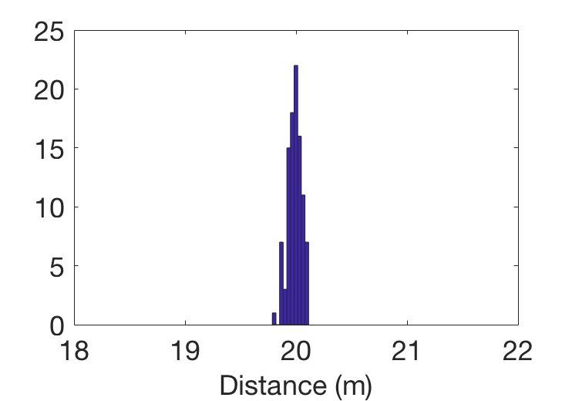
Distance: 20m
Linewidth: 10MHz²/Hz
Chirp bandwidth: 10GHz
Scan time: 10us
Bin-size limited resolution: 1.5cm
100 samples
Periodogram + peak-finding
𝜎=58.7cm
LSE
MLE
𝜎=8.2cm
𝜎=6.4cm
Notes:
S_i(f) = \frac{{i_0}^2}{2}\left[ \frac{{\tau}_c/(2\pi)}{1+\left(\pi f {\tau}_c \right)^2} \left\{ 1- e^{-\frac{2\tau}{{\tau}_c}} \left[ \cos(2\pi f\tau) + \frac{1}{\pi f \tau_c} \sin(2\pi f \tau) \right] \right\} \right]
\tau_c = \frac{2}{\textrm{linewidth}},\quad i_0: \textrm{nominal photocurrent amplitude},\quad \tau: \textrm{path delay}

Slide 8
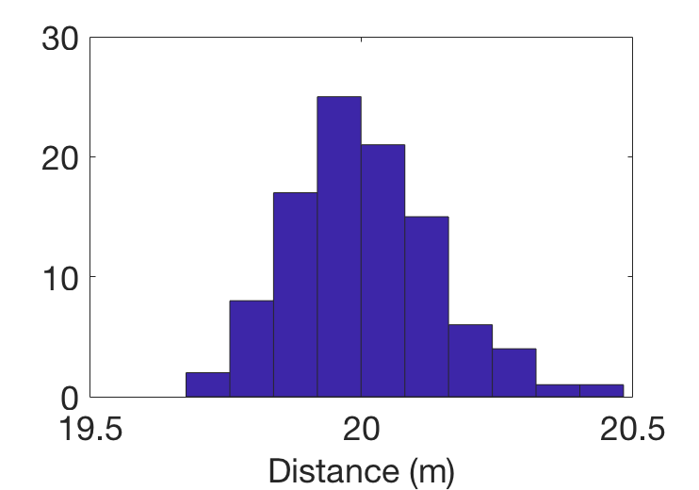
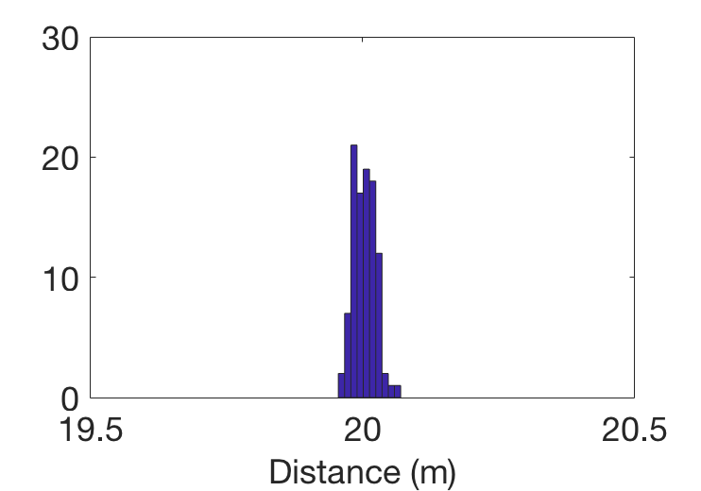
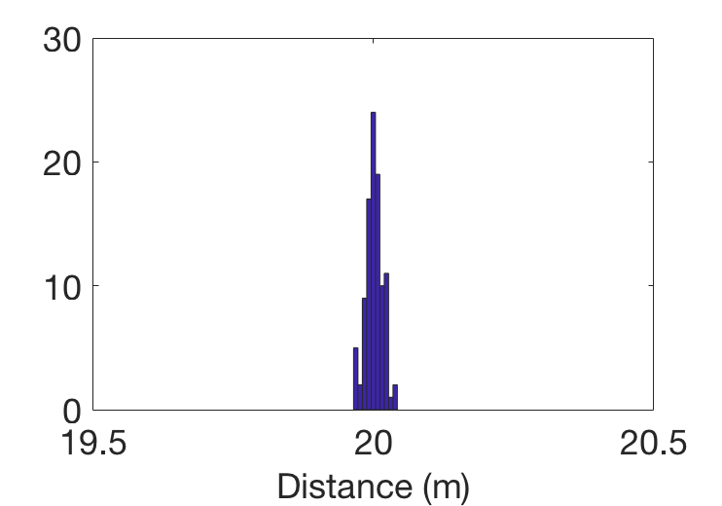
Distance: 20m
Linewidth: 10MHz²/Hz
Chirp bandwidth: 40GHz
Scan time: 10us
Bin-size limited resolution: 0.375cm
100 samples
Periodogram + peak-finding
𝜎=13.8cm
LSE
MLE
𝜎=2.03cm
𝜎=1.5cm
Notes:
S_i(f) = \frac{{i_0}^2}{2}\left[ \frac{{\tau}_c/(2\pi)}{1+\left(\pi f {\tau}_c \right)^2} \left\{ 1- e^{-\frac{2\tau}{{\tau}_c}} \left[ \cos(2\pi f\tau) + \frac{1}{\pi f \tau_c} \sin(2\pi f \tau) \right] \right\} \right]
\tau_c = \frac{2}{\textrm{linewidth}},\quad i_0: \textrm{nominal photocurrent amplitude},\quad \tau: \textrm{path delay}

Slide 9
Remaining work
Plug everything into the end-to-end model, include shot noise, and see what is the required RX power to achieve desired accuracy (say 10cm) for different:
Distance (this is not that critical once you’re in the incoherence regime)
Linewidth
Chirp bandwidth
Scan time
Derive theoretical lower bound for this fitting (Cramer-Rao lower bound)
Notes:
S_i(f) = \frac{{i_0}^2}{2}\left[ \frac{{\tau}_c/(2\pi)}{1+\left(\pi f {\tau}_c \right)^2} \left\{ 1- e^{-\frac{2\tau}{{\tau}_c}} \left[ \cos(2\pi f\tau) + \frac{1}{\pi f \tau_c} \sin(2\pi f \tau) \right] \right\} \right]
\tau_c = \frac{2}{\textrm{linewidth}},\quad i_0: \textrm{nominal photocurrent amplitude},\quad \tau: \textrm{path delay}

Slide 10
Feedforward phase noise cancellation
Key idea
Phase
mod.
Final
laser out
Analog PD for removing phase ramp
PD
Integrate
A
Notes:
S_i(f) = \frac{{i_0}^2}{2}\left[ \frac{{\tau}_c/(2\pi)}{1+\left(\pi f {\tau}_c \right)^2} \left\{ 1- e^{-\frac{2\tau}{{\tau}_c}} \left[ \cos(2\pi f\tau) + \frac{1}{\pi f \tau_c} \sin(2\pi f \tau) \right] \right\} \right]
\tau_c = \frac{2}{\textrm{linewidth}},\quad i_0: \textrm{nominal photocurrent amplitude},\quad \tau: \textrm{path delay}

Slide 11
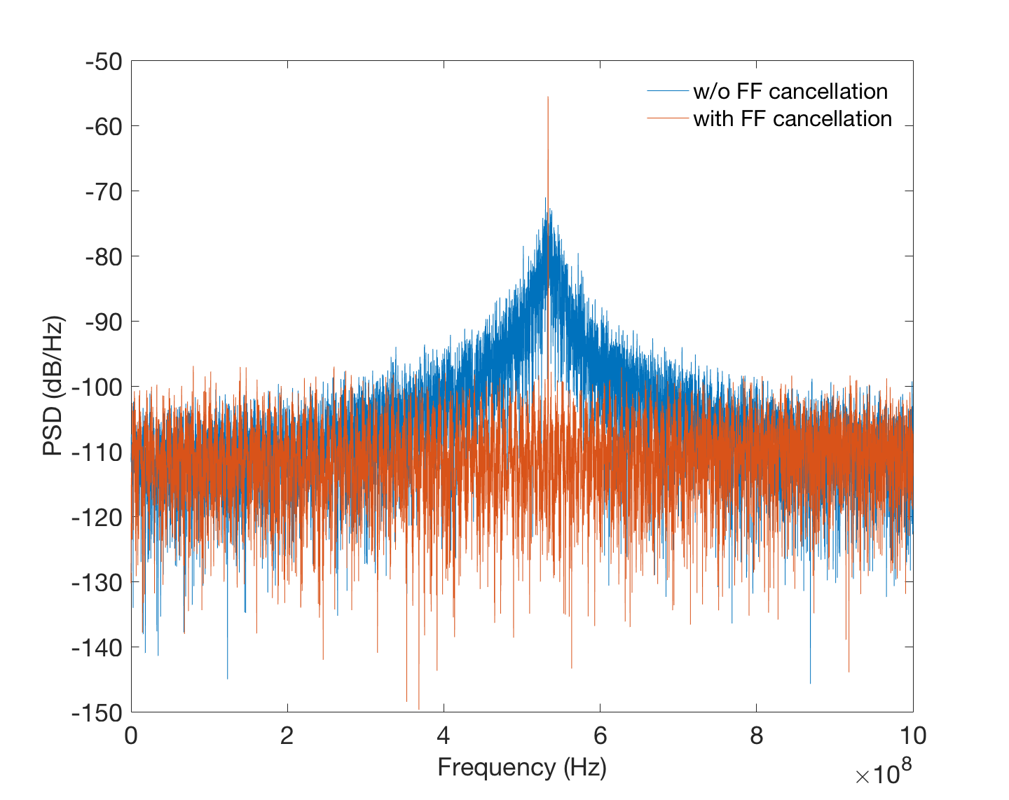
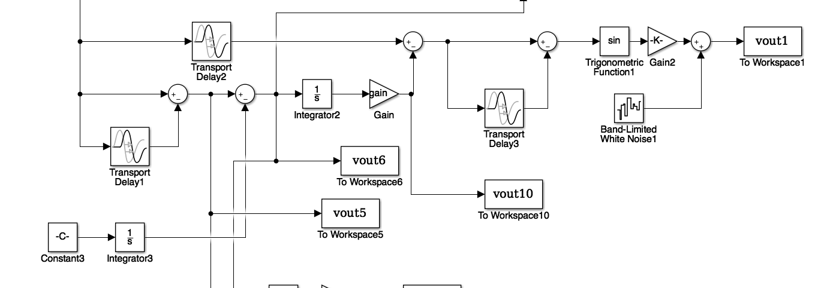
Simulation result
Distance: 20m
Linewidth: 10MHz²/Hz
Scan time: 10us
Chirp bandwidth: 40GHz
MZI delay difference: 1ns

Slide 12
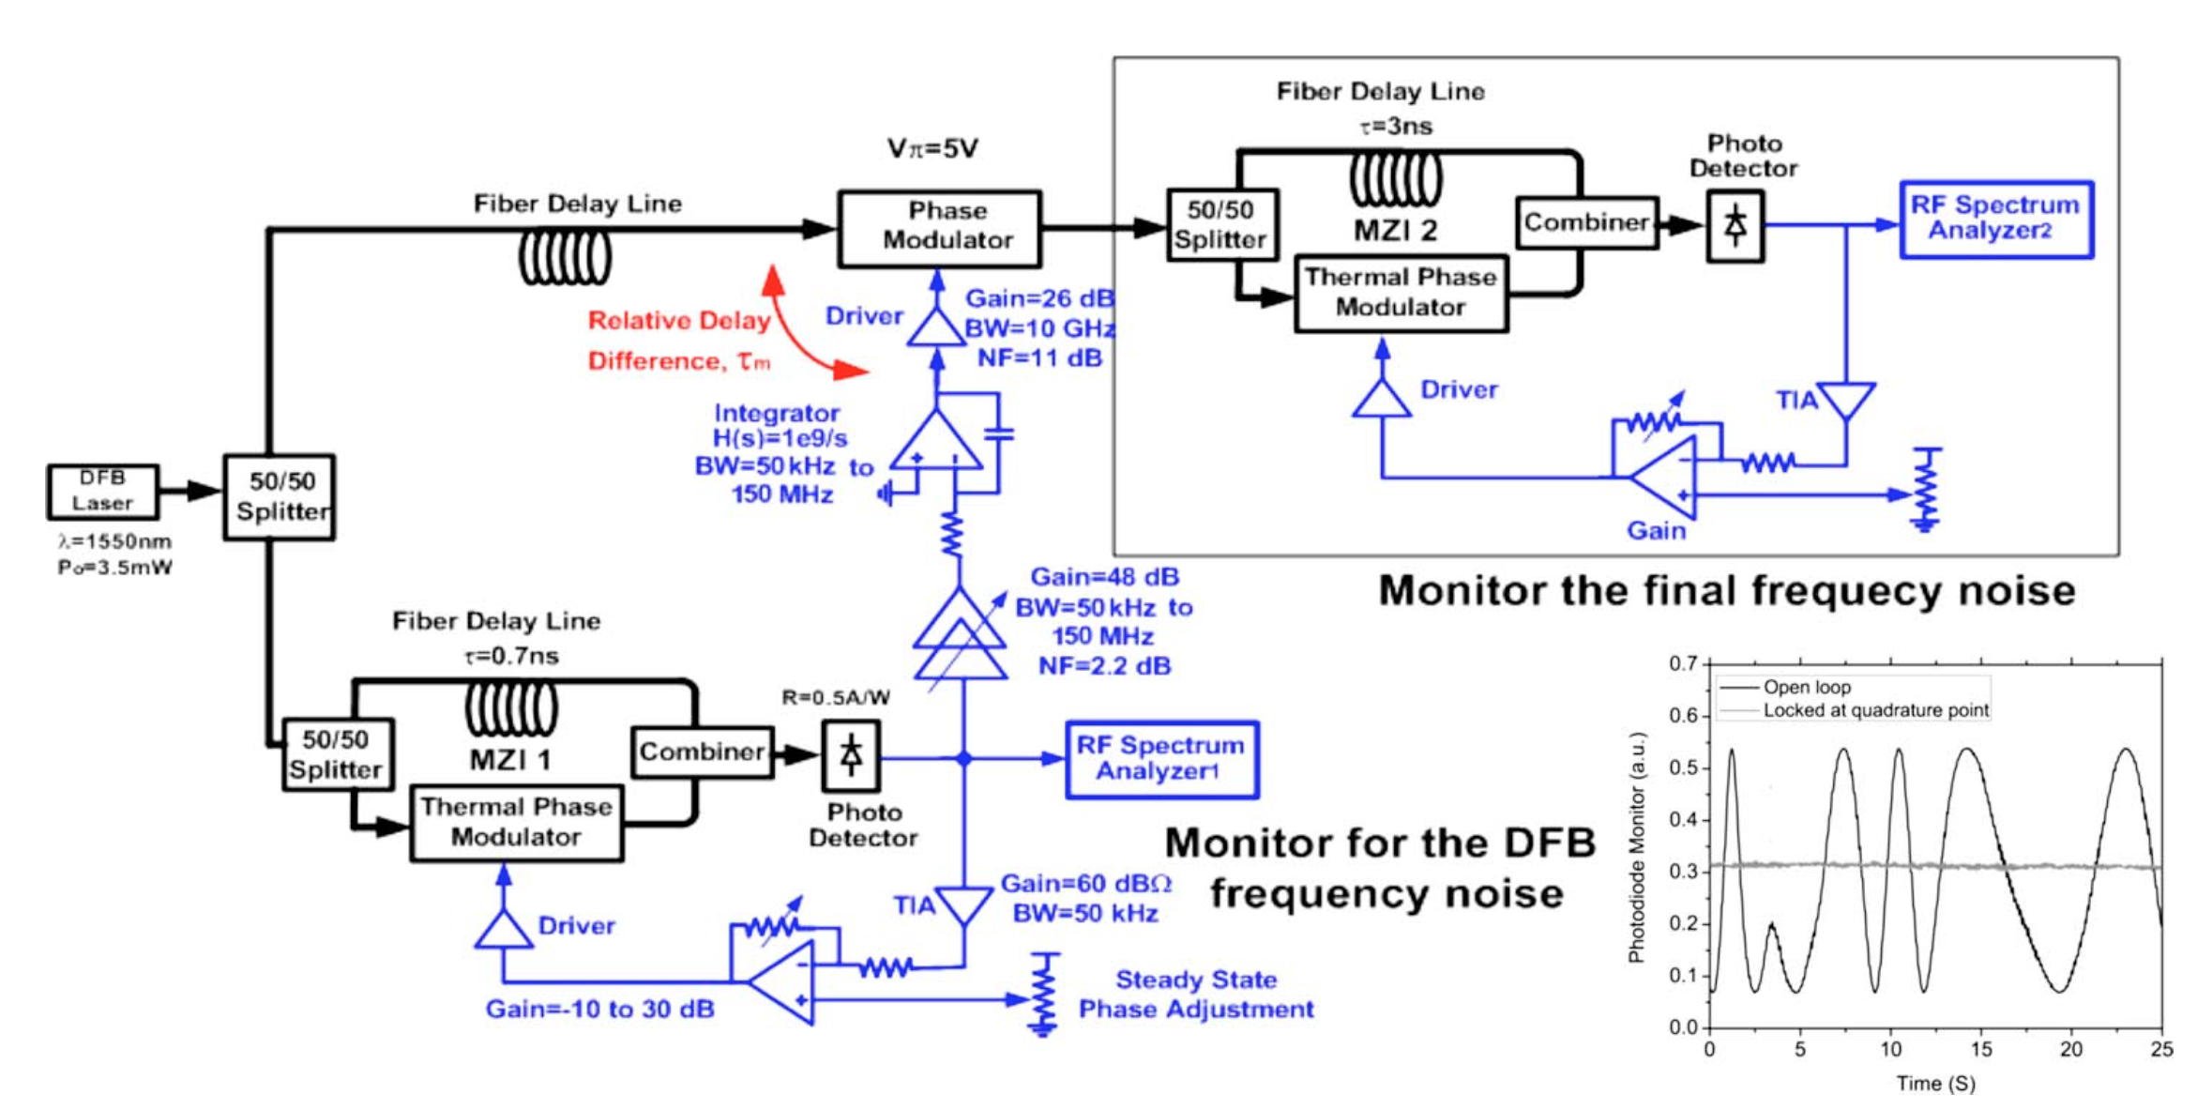
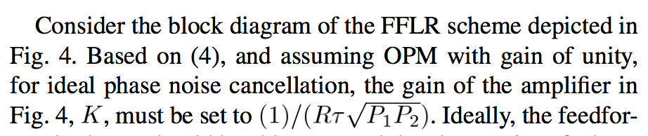
Works really great in simulation, however..
Gain/delay needs to be matched quite well
Gain of FF path ~ tau (a few ns)
Requires huge gain…
Also, removal of phase ramp using analog mixer can introduce a lot of noise, especially concerning as the gain of asymmetric MZI is very small
Maybe multiplying phase directly could help?

Slide 15
Optical PLL for FMCW Lidar
Taehwan Kim
09/25/17

Slide 16
Lidar
Uses light to sense the distance/velocity of the remote target
Using light as sensing medium is advantageous mainly because the wavelength is small (compared to mmWave, for example)
Diffraction-limited system: sensing with light improves lateral resolution for given device size
In other words, can build high-resolution sensor which is also very compact
Integrated optics: co-existence of powerful electronics & photonic devices on a single substrate is now possible

Slide 17
Lidar
Uses light to sense the distance/velocity of the remote target
Using light as sensing medium is advantageous mainly because the wavelength is small (compared to mmWave, for example)
Diffraction-limited system: sensing with light improves lateral resolution for given device size
In other words, can build high-resolution sensor which is also very compact
Integrated optics: co-existence of powerful electronics & photonic devices on a single substrate is now possible

Slide 18
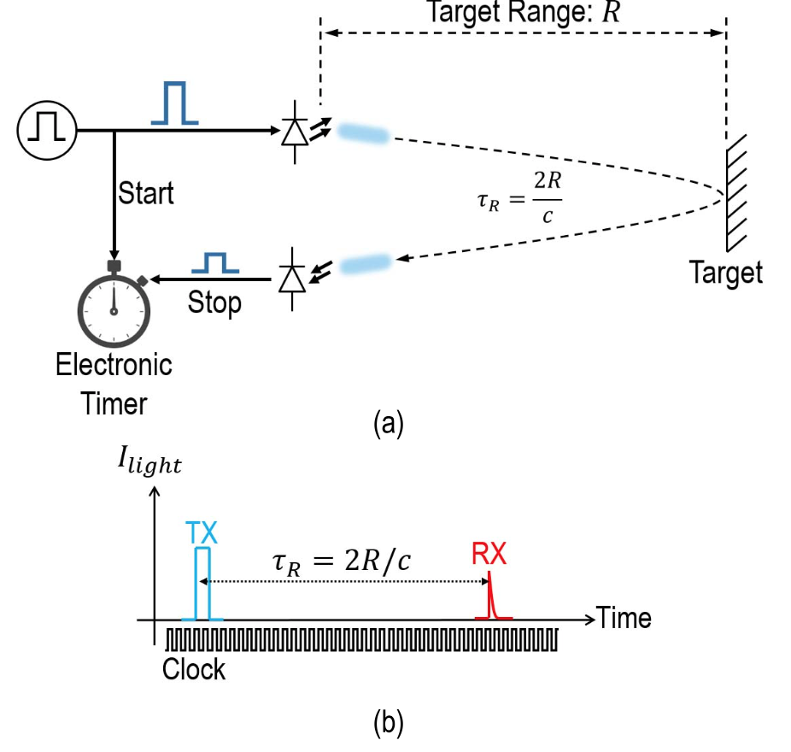
Lidar scheme summary
Pulsed vs. FMCW
[Behroozpour 2013]
Pulsed lidar
FMCW lidar

Slide 19
Pulsed lidar
Fundamental tradeoff between peak power vs. resolution
tau = 1.5cm → 10ps
SNR determined by the # of photons within tau
Requires high-speed electrical FE
Geiger-mode APD required for shot-noise limited receiver
No interference rejection

Slide 20
FMCW lidar
No tradeoff between peak power vs. resolution
Requires longer integration for resolving smaller frequency difference
No need for fast electrical FE
Coherent RX achieves shot-noise limited detection with normal PD
Interference rejection
Requires laser with broadband, stable, continuous wavelength tuning capability & narrow linewidth

Slide 21
Today: modulator design for FMCW lidar
Linearity of the modulation pattern
Phase noise

Slide 22
Impact of FMCW modulator performance
1. Linearity of the modulation pattern
Due to the nonlinearity in the laser tuning & bandwidth limit, modulation pattern could diverge from the ideal → non-constant chirp rate
Causes frequency uncertainty in the beating tone, degrading SNR
Some kind of feedback control which senses the chirp rate & corrects the tuning signal required
Laser Frequency
Δf
Laser Frequency
Δf
Time
Time

Slide 23
Impact of FMCW modulator performance
20cm
2m
2. Laser phase noise
As 𝜏_{R} goes up, PN of TX/RX beams are less correlated (less coherent)
Beating tone becomes weaker & noise floor go up
[Vasilyev 2013]

Slide 24
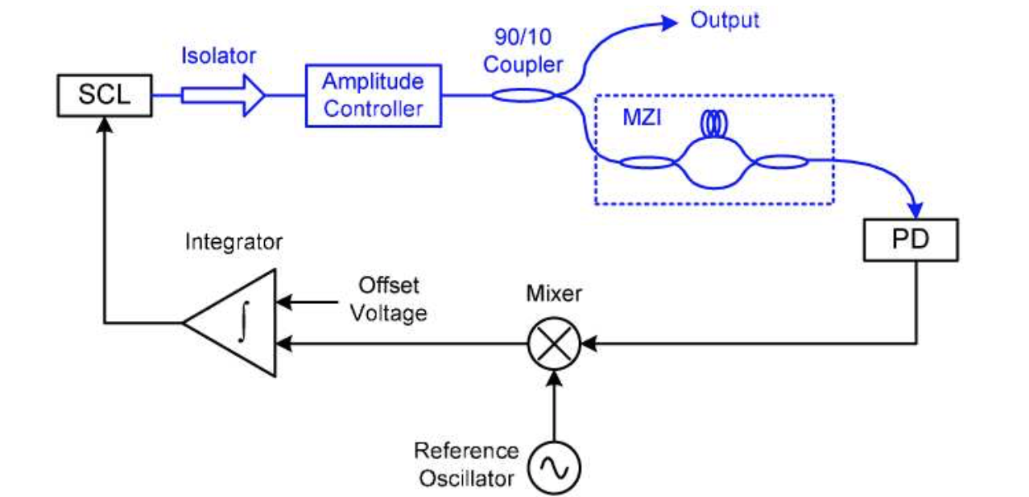
FMCW modulation closed-loop control
How to sense the instantaneous laser chirp rate?
Lidar → known chirp rate, find out the distance
Laser controller → For known distance, find out the chirp rate
Target emulation
with known 𝜏
Photocurrent frequency indicates instantaneous chirp rate → compare with ref. to generate error signal for laser control
[Satyan 2009]

Slide 25
FMCW linearization: implementation
Same system as normal PLL
Integrator + laser + MZI-PD is equivalent to single VCO
Digital implementation to accommodate wide range of reference oscillation frequency (different chirp rates)
Triangular mod. by flipping integrator sign
CMOS
Photonics

Slide 26
Digital OPLL Implementation
1.28GHz
8ps LSB
10MHz
128
7b
(couter)
7b
Signed 10b
10MHz
(fastest)
Sub-sampling to make this run at slower fb

Slide 27
Digital backend functionalities
Variable reference frequency operation
Feedback clock can be slower than nominal (10MHz) as we might want to use a laser with lower chirp rate or smaller chirping bandwidth
However, fine TDC resolution is set by inverter delay
By using frequency detector to introduce frequency offset, we can make the loop work with slower feedback frequency
Error values are updated only at the fb clock positive edge (sub-sampling operation)
All-pass triangular modulation by synchronized sign flipping

Slide 28
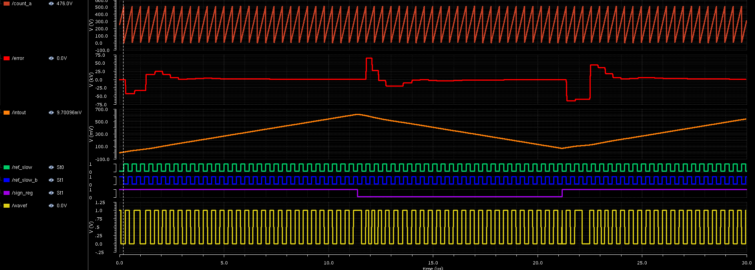
All-pass triangular modulation
When the sign is flipped, 𝜋 phase error is introduced instantaneously
(takes some time to settle, depending on loop BW)
Sign flipping – synchronized with ref. clk
Notes:
S_{t_{q,TDC}}(e^{j\omega T_R})=\frac{\left(\Delta t_{del}\right)^2}{12}

Slide 29

No Frequency Offset, Two Pt Mod On
By resetting the counter (coarse TDC) when the sign is flipped, we can cancel this 𝜋 phase error & hide sign flipping from the loop
Notes:
S_{t_{q,TDC}}(e^{j\omega T_R})=\frac{\left(\Delta t_{del}\right)^2}{12}

Slide 30
Noise Sources in Optical PLL
PIR control:
Proportional path : 𝛼
Integration path: 𝛽
Maximize laser noise suppression
Minimize additive noise from PLL
Minimize effective linewidth →
Notes:
S_{t_{q,TDC}}(e^{j\omega T_R})=\frac{\left(\Delta t_{del}\right)^2}{12}

Slide 31
Looking at the laser PSD, it is highpass → need to maximize loop bandwidth
Choose design variables accordingly so that additive noise is not exceeding laser phase noise
TDC LSB
LF gain
Current DAC LSB
Capacitance size
Buffer gain
Noise TF
Notes:
\frac{\phi_{out}}{\phi_{n,laser}}(s)=\frac{s^2}{s^2+\left( \frac{\tau}{2\pi} \frac{K_{laser}}{\Delta t_{del}} \frac{A_{drv}I_{LSB}}{C} \right) (\alpha s T_R + \beta)}=\frac{s^2}{s^2+\eta\alpha s T_R + \eta\beta} \frac{\phi_{out}}{t_{q,TDC}}(s)=\frac{1}{s}\frac{\frac{2\pi}{\tau}\eta (\alpha s T_R+\beta)}{s^2+\eta\alpha s T_R + \eta\beta}
S_{\phi_{out}}(f)|_{iDAC}=\frac{1}{T_R} \left| \frac{\phi_{out}}{t_{q,iDAC}}(f) \right|^2 S_{t_{q,iDAC}(e^{j\omega T_R})}
S_{\phi_{out}}(f)|_{laser}= \left| \frac{\phi_{out}}{\phi_{n,laser}}(f) \right|^2 S_{\phi_{n,laser}}(f) = 2\pi\Delta\nu \left| \frac{s}{s^2+s\frac{\omega_0}{Q} + \omega_0^2} \right|^2
S_{\phi_{out}}(f)|_{iDAC}=\frac{1}{T_R} \left| \frac{\phi_{out}}{t_{q,iDAC}}(f) \right|^2 S_{t_{q,iDAC}(e^{j\omega T_R})}=\frac{1}{12T_R} \left| \frac{\frac{2\pi}{\tau}\frac{\Delta t_{del}}{\alpha} \frac{\omega_0}{Q}}{s^2+s\frac{\omega_0}{Q} + \omega_0^2} \right|^2
S_{\phi_{out}}(f)|_{TDC}=\frac{1}{T_R} \left| \frac{\phi_{out}}{t_{q,TDC}}(f) \right|^2 S_{t_{q,TDC}(e^{j\omega T_R})}=\frac{(\Delta t_{del})^2}{12T_R} \left| \frac{1}{s} \frac{\frac{2\pi}{\tau} \eta T_R (s + \omega_z)}{s^2+ s\omega_0/Q + \omega_0^2} \right|^2

Slide 32
Design Procedure
Maximize the loop bandwidth while ensuring stability
The wider the bandwidth, the more the laser noise is suppressed
Set bandwidth to be 15% of the reference clock, Q=0.5
η and α/β determined
Now to choose α, I_{LSB}, C
Notes:
S_i(f) = \frac{{i_0}^2}{2}\left[ \frac{{\tau}_c/(2\pi)}{1+\left(\pi f {\tau}_c \right)^2} \left\{ 1- e^{-\frac{2\tau}{{\tau}_c}} \left[ \cos(2\pi f\tau) + \frac{1}{\pi f \tau_c} \sin(2\pi f \tau) \right] \right\} \right]
\tau_c = \frac{2}{\textrm{linewidth}},\quad i_0: \textrm{nominal photocurrent amplitude},\quad \tau: \textrm{path delay}

Slide 33
Design Procedure
Set α so that iDAC quantization noise is balanced with others
It fixes I_{LSB}/C ratio
Finally, increase I_{LSB} & C until iDAC thermal noise is balanced with others
Notes:
S_i(f) = \frac{{i_0}^2}{2}\left[ \frac{{\tau}_c/(2\pi)}{1+\left(\pi f {\tau}_c \right)^2} \left\{ 1- e^{-\frac{2\tau}{{\tau}_c}} \left[ \cos(2\pi f\tau) + \frac{1}{\pi f \tau_c} \sin(2\pi f \tau) \right] \right\} \right]
\tau_c = \frac{2}{\textrm{linewidth}},\quad i_0: \textrm{nominal photocurrent amplitude},\quad \tau: \textrm{path delay}

Slide 34
Plugging in Real Numbers
Given values:
Design parameters:
Runtime Parameters:

Slide 35
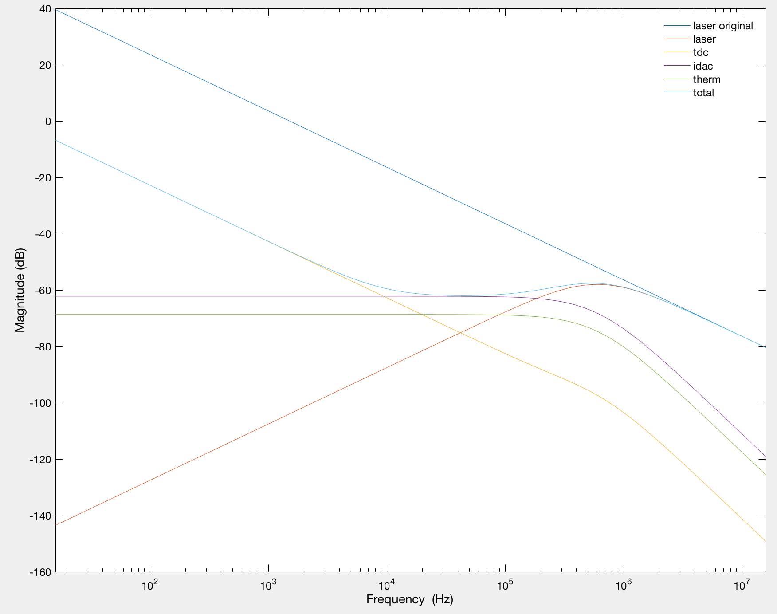
Plugging in Real Numbers

Slide 36
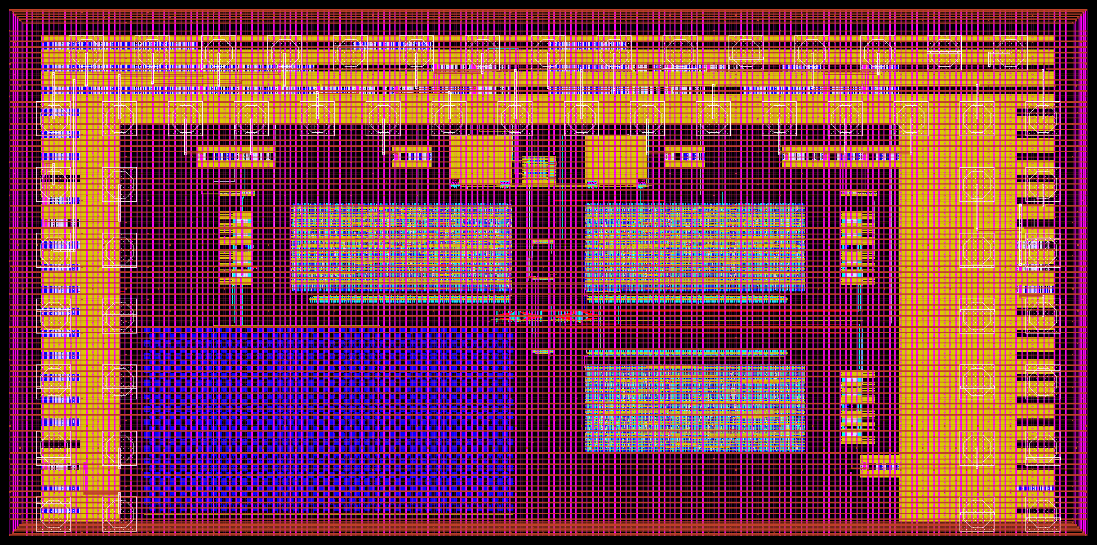
Optical PLL prototype chip (Aug.`17): 3x1.5mm

Slide 37
Optical PLL prototype chip (Aug.`17): 3x1.5mm
Variant 1
CML2CMOS
Variant 2
(variant 1 - capacitor)
Cur. Mir.
Variant 3
(variant 2 - laser buffer - TIA)

Slide 38
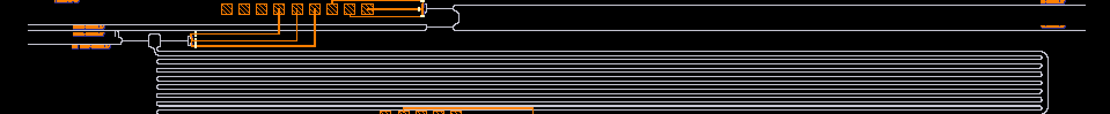
Photonics chip from EPHI (Mar.`15)
BPD (got 20uApp for 0dBm)
Lidar TX/RX
LO Path
Delay (1.14ns)
9:1 tap

Slide 39
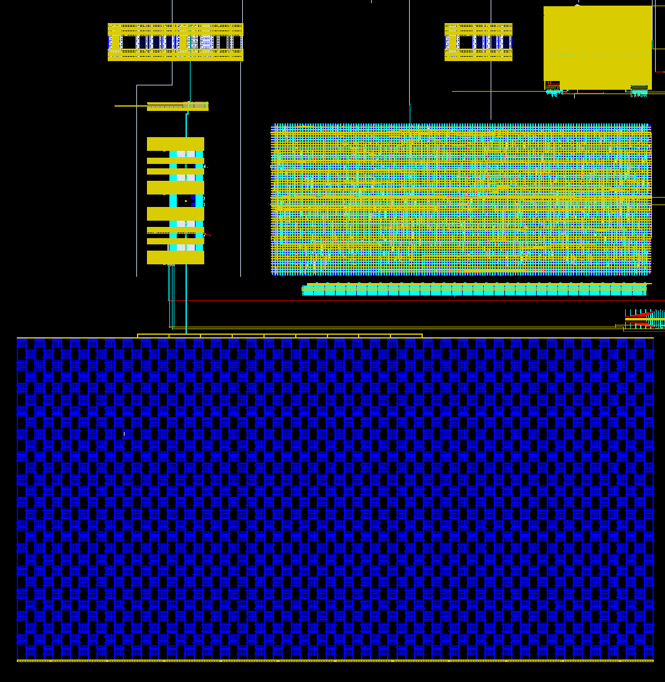
Optical PLL prototype chip (Aug.`17): 3x1.5mm
TIA
(DODOS)
Buffer
iDACs
Backend
Fine TDC chain
Capacitor

Slide 40
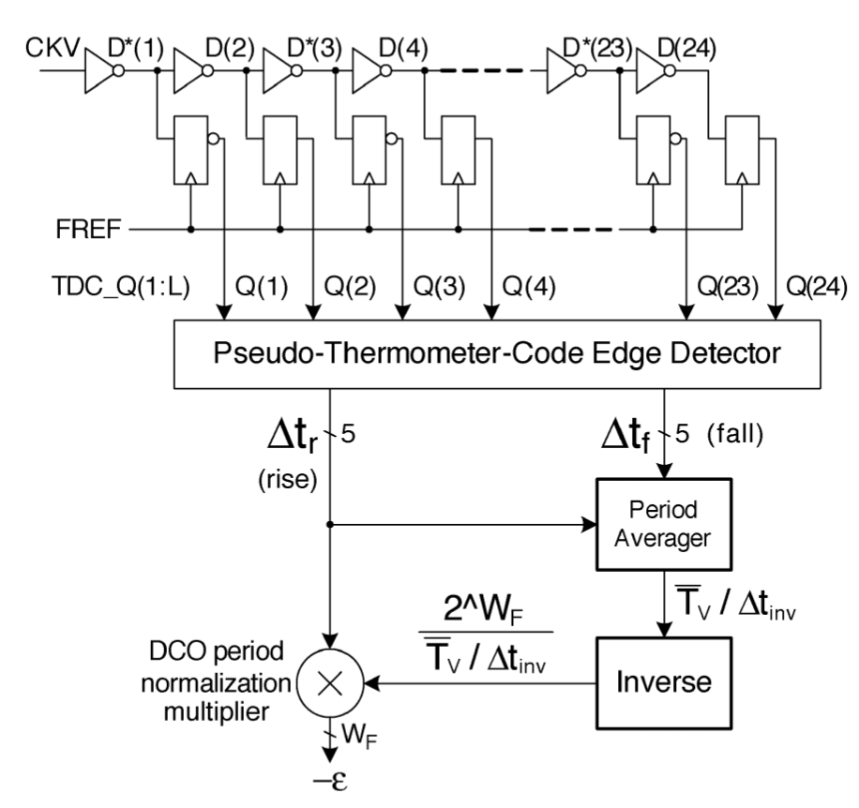
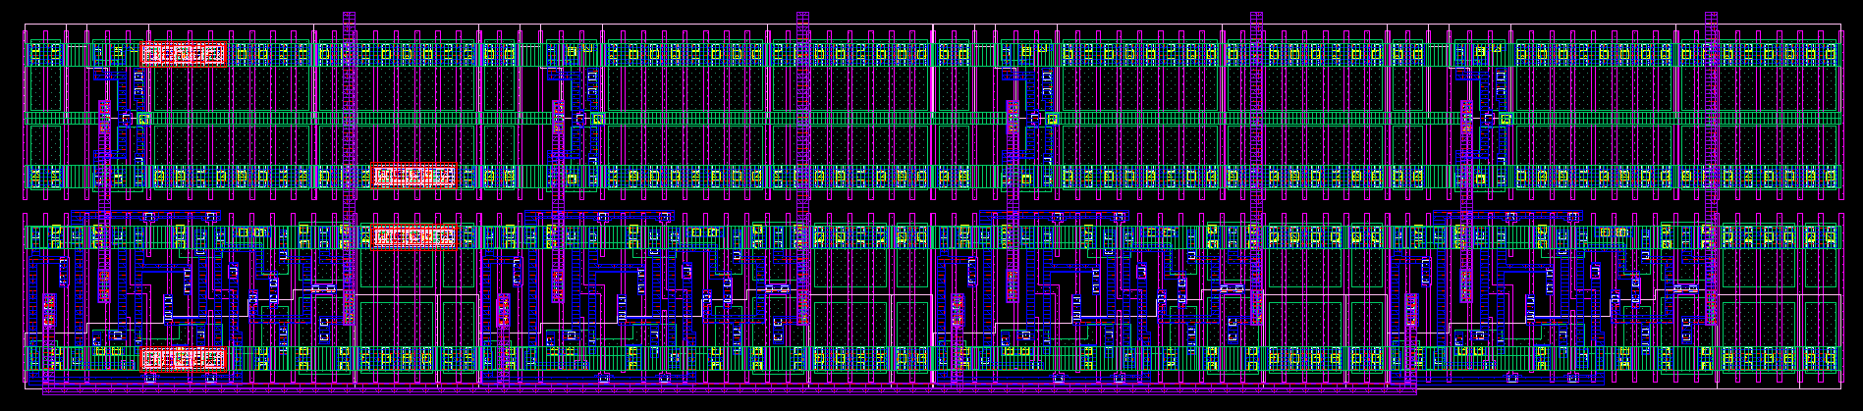
Fine TDC
Standard inverter-chain based TDC, 8ps LSB @ 1V
128 segments -> 7bit
Capable of calibrating the normalization factor by measuring fast clock period in # of inverter delays (nominal: ~100)
Clock tree to minimize the skew
[Staszewski 2004]
Clock tree

Slide 41
Sign generator for triangular waveform
(From pad)
(From pad)

Slide 42
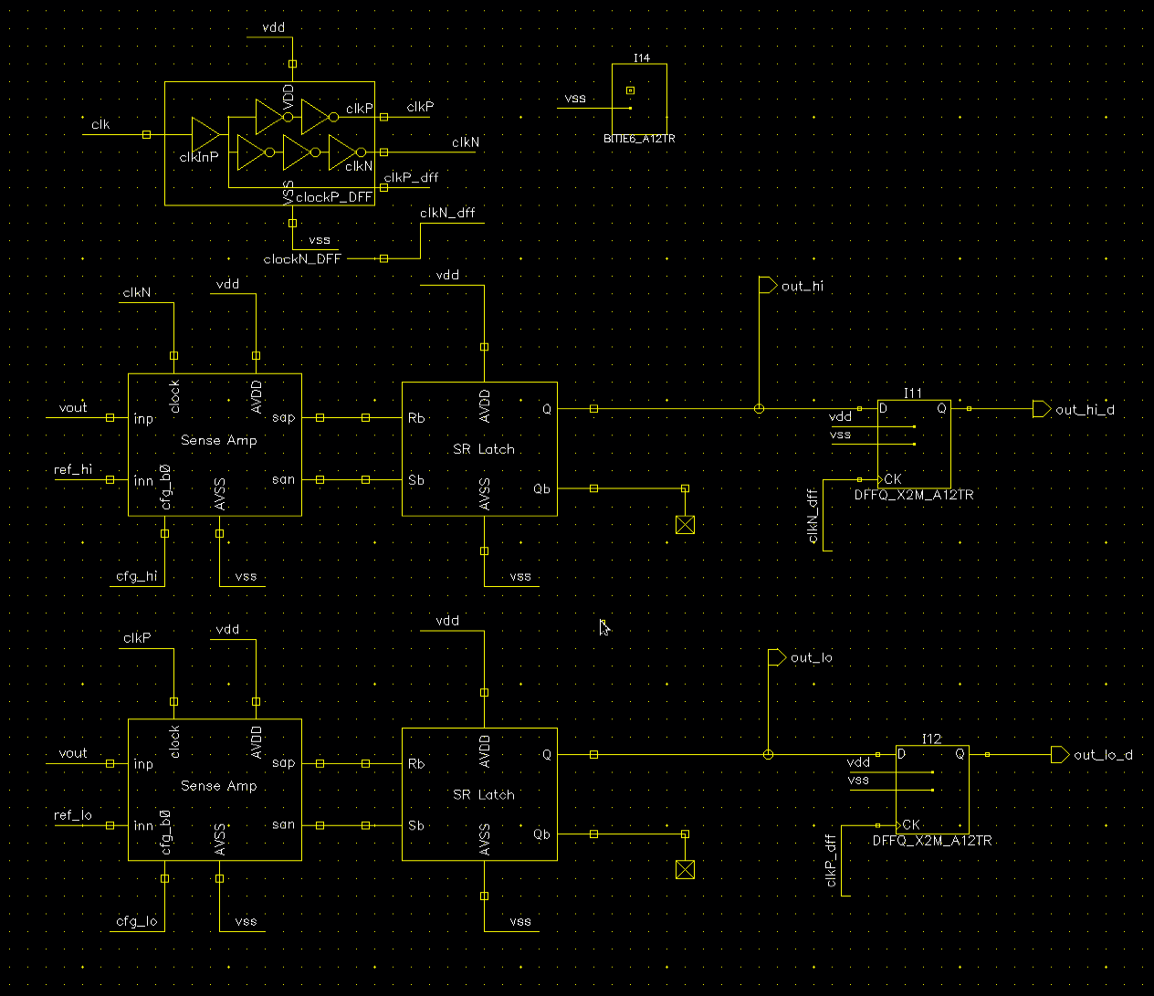
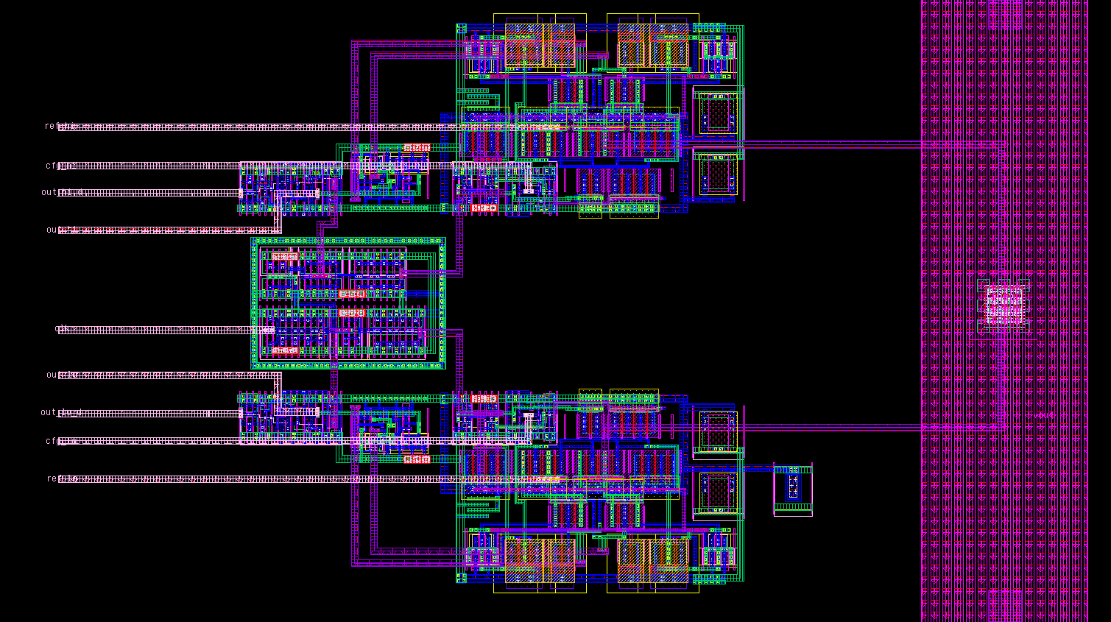
Sign generator for triangular waveform
In digital backend
(From pad)
(From pad)
Nandish’s StrongArm design reused

Slide 43
Current DAC & capacitance
Push-pull DAC (9b)
Desiged LSB 100nA
Pulse width of sign & sign_b are slightly reduced to make sure it’s either sinking or sourcing (not both)
Reference current of sink/source DAC can be independently controlled by central current mirror (can correct current mismatch off-chip)
Cap: dgncap (3.8x4.8u*2016) ~ 3.6nF @ 0.9V
9b
9b
9b
9b

Slide 44
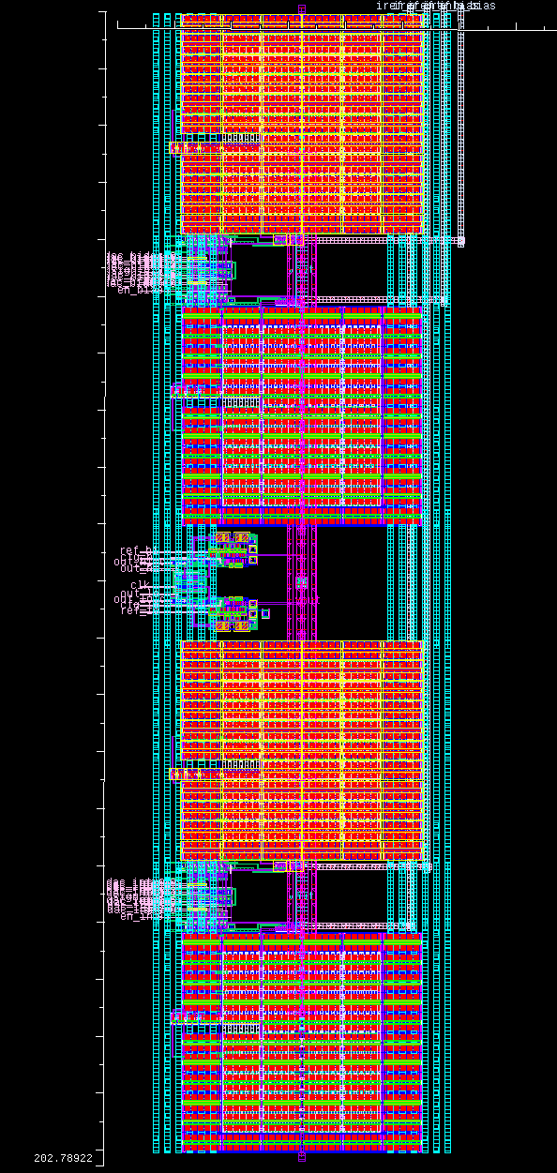
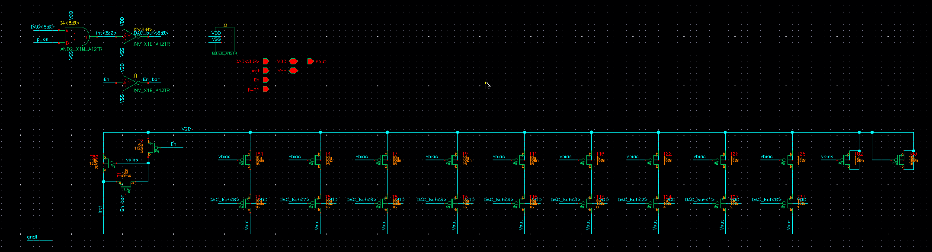
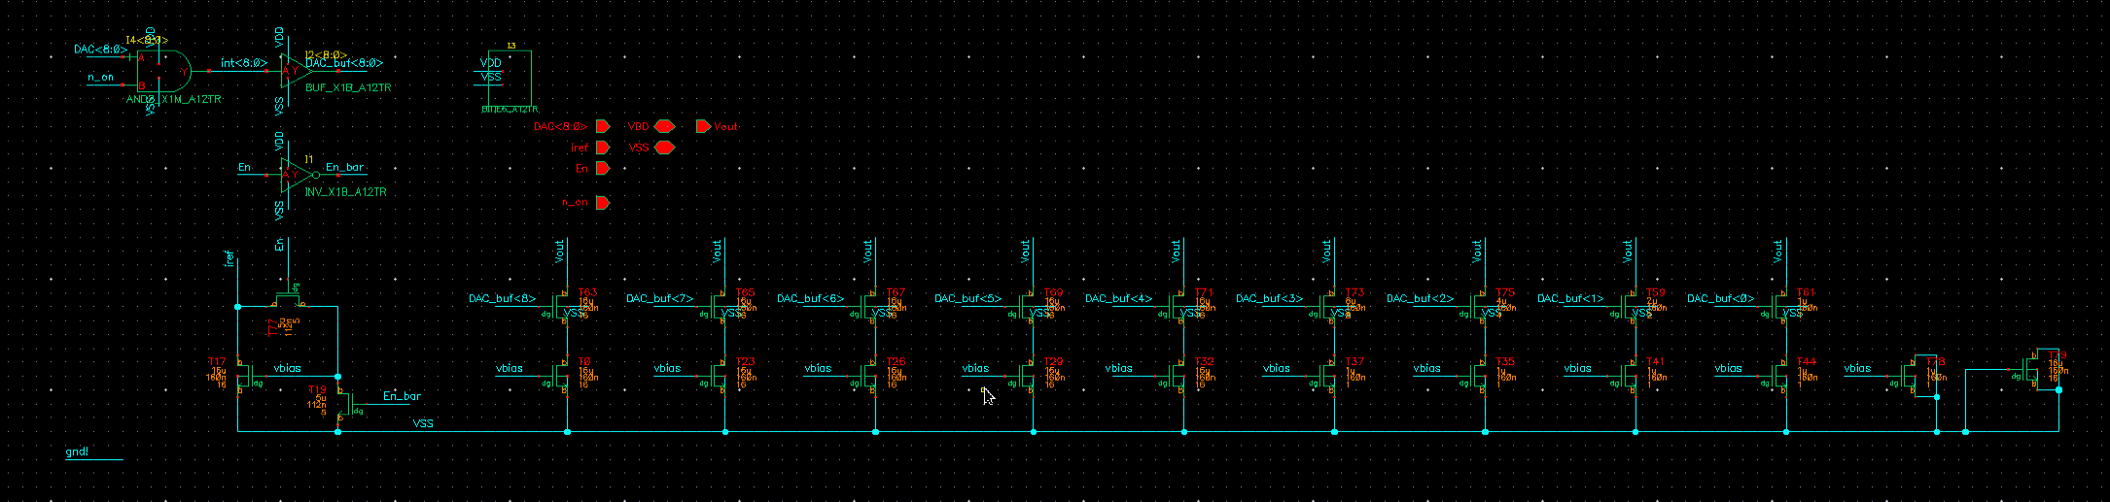
Current DAC
Based on Pavan’s current mirror design

Slide 45
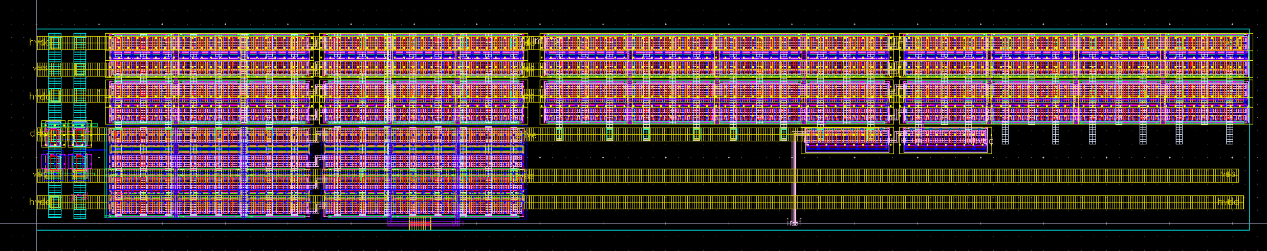
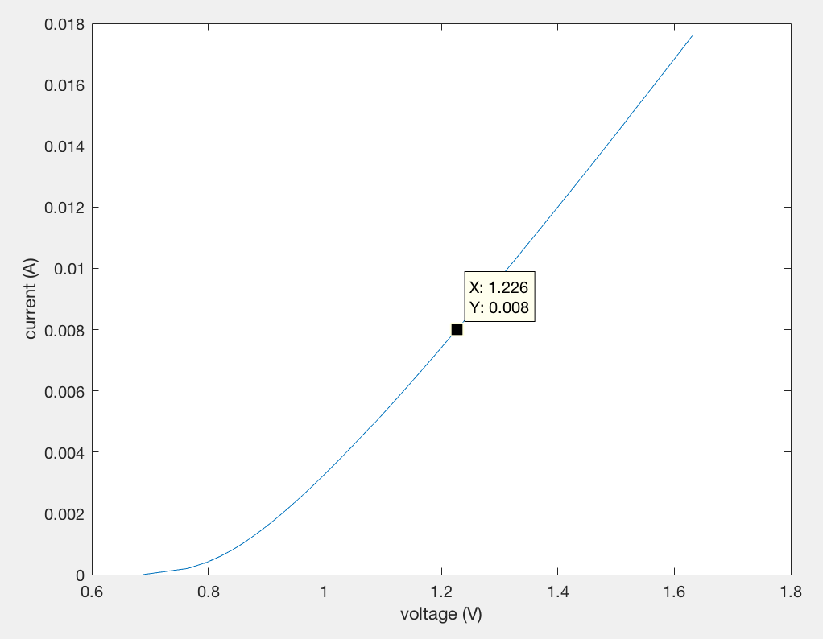
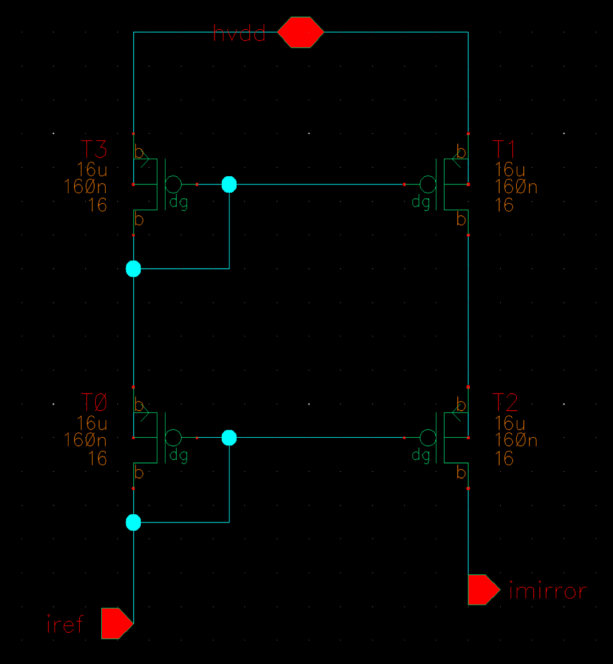
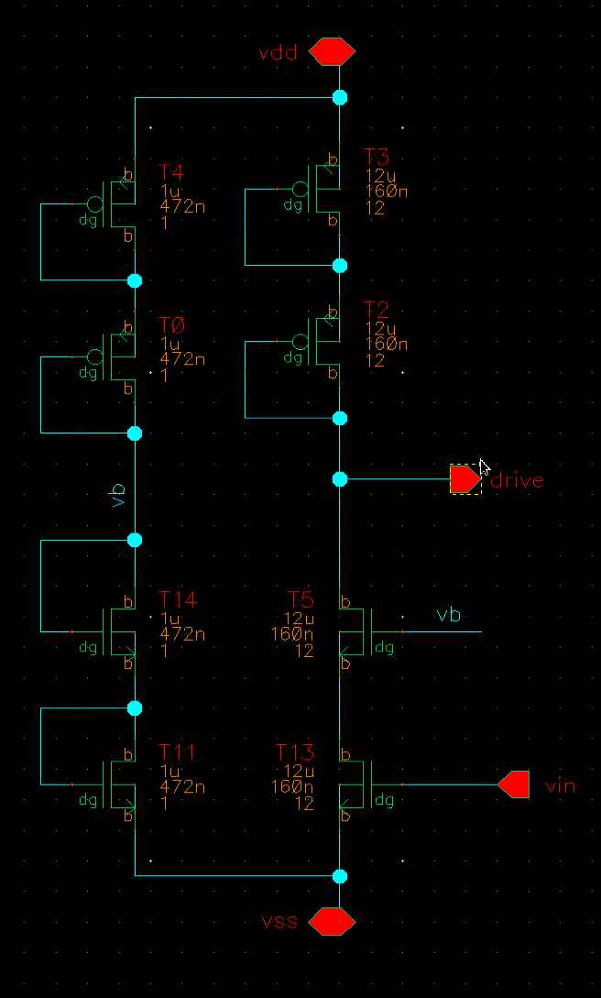
Laser buffer
Laser tuning input V/I curve
Desired bias point
(8mA, 1.27V)
Roughly modeled as diode + 50Ohms in series
Dedicated current reference for biasing at 8mA
For 100GHz chirp BW, ~3mApp swing required
Designed transconductance: 20mS

